Slide 1
The FRC Control System
Brought to you by the electrical subteam of FRC Team 2177, the Robettes

Slide 2
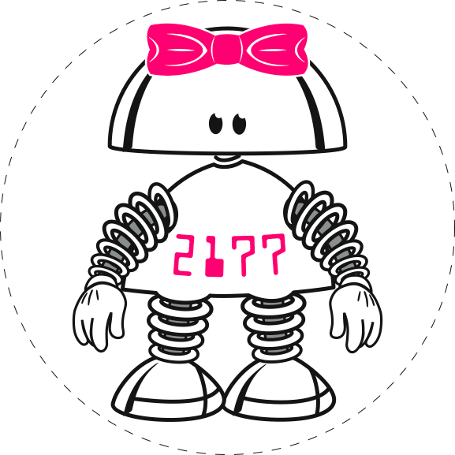
Table of Contents
Power Distribution Panel (PDP)
Pneumatics/Pneumatics Control Module (PCM)
Motor Controllers
Talons
Victors
2016 Radio
Wiring Tips
roboRIO & MPX
Voltage Regulator Module

Slide 3
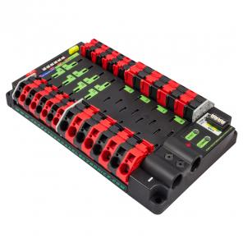
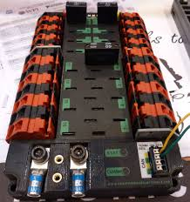
Power Distribution Panel (PDP) cont.
PDP control system:
Notes:
no regulated outputs, less ports/ smaller for the 20 30 amp, allows you to monitor the current across any breaker.
you need to use crimp battery connectors on the wire for connecting to the PDP.
has can

Slide 4
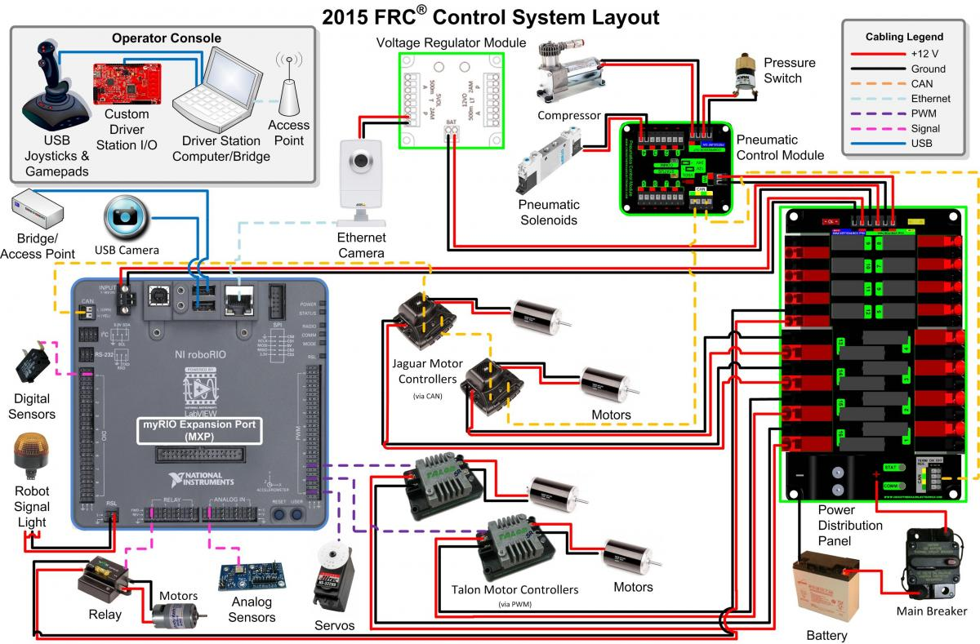
PDP Function
Function is to
distribute power
to the rest of
the components

Slide 5
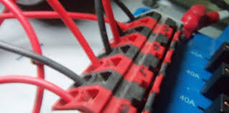
PDP Use
The panel is hooked up to the battery through the Main Breaker
The motor controllers are then plugged into the Power Distribution Panel to operate the robot
Notes:
hooked up same way as in the old control system

Slide 6
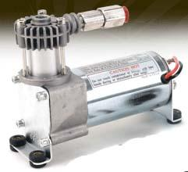
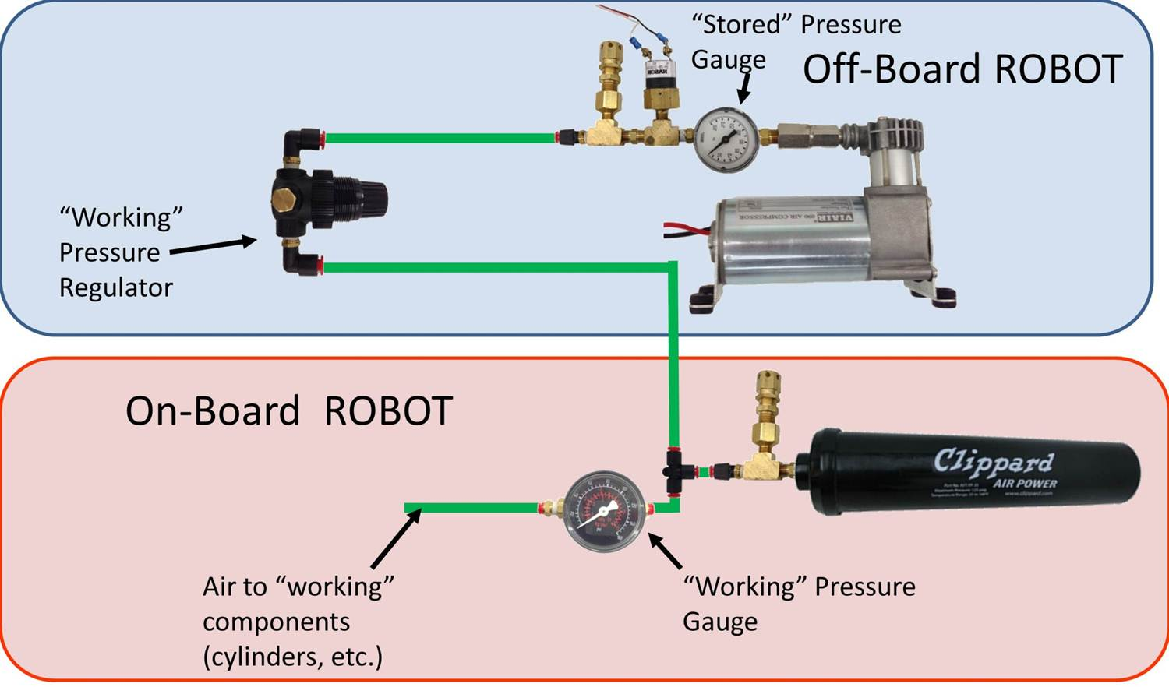
Pneumatics
The pneumatic system runs on compressed air
Notes:
In last years robot, we used the pneumatics cylinder to release the catipult and also to raise and lower the part to pick- up the ball off the ground

Slide 7
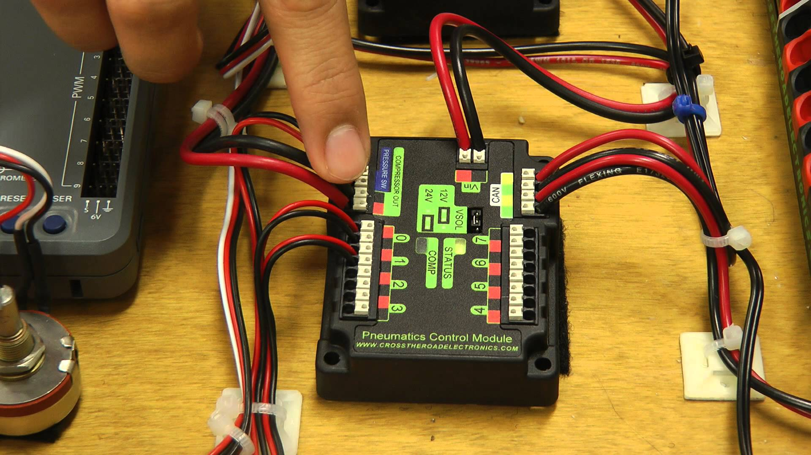
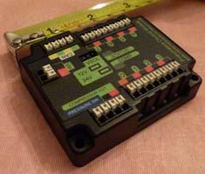
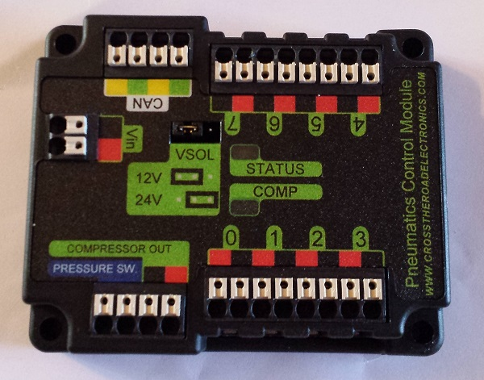
Pneumatics Control Module (PCM)

Slide 8
Pneumatics Control Module Function
Controls all the components for the pneumatics system
The PCM is controlled through CAN
and can be switched from 12V to 24V
The PCM has specified ports for the compressor and the pressure switch
Notes:
In the past, compressor had to be run from spike through digital side car. No programming for compressor

Slide 9
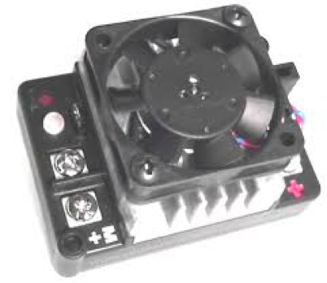
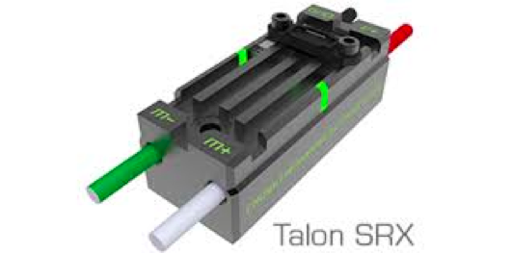
Motor Controllers
Motor controllers control the speed produced by the motors, as well as regulate the speed variation.
List of legal motor controllers are located on the FRC blog post at: http://www.usfirst.org/roboticsprograms/frc/blog-2016-motor-controllers
In addition to the illegal motor controllers, BaneBots’ 775 and 550 are no longer legal for the 2016 season.
Notes:
the motor controllers are like the appendages
there are four different types of motor controllers

Slide 10
Talons
Talons are a type of motor controller, and talons have the option to attach a fan to keep the motor controller cool when it is running for a long period of time
The talons are smaller and more compact they also have pre-attached wires; which helps makes sure the wires won’t come off, but can hinder reusability.
Notes:
Talons
new version this year
linear
small footprint
Variable speed control
PWM

Slide 11
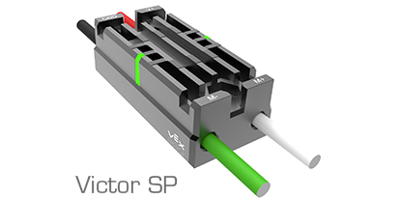
Victors
The Victor, Another motor controller, is slightly smaller
than the talon.
Less risk of shavings getting stuck in the victor. The victor also has pre-attached wires, which makes sure the wires won’t come off, but can hinder reusability for future seasons
Notes:
Victors
variable speed control
PWM
two kinds
888 (newer)
884 (older. can’t get anymore. can still use)
not linear (888 is more linear than 884)
come with fans

Slide 12
Talon & Victor Wires
Talons and Victors should be close to the PDP so that wires don’t have to be lengthened or shortened
The wires on the motor side should utilize connectors so they don’t need to be shortened every year until they are unusable.

Slide 13
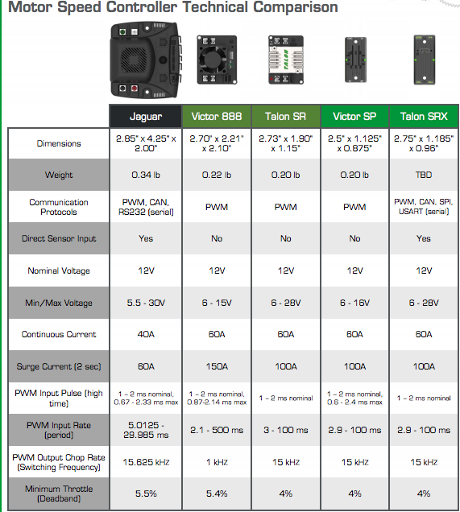

Slide 14
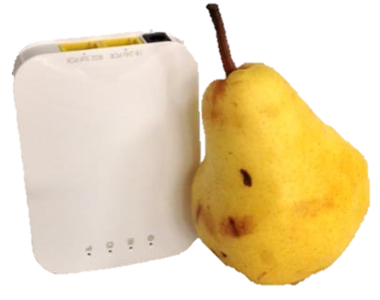
2016 Wireless Radio
New Radio Pros:
Is smaller than a pear
It is still able to use one device, while at home, or on the competition field
Still uses diagnostic LEDs, and has features that are used to eliminate the “Christmas tree” phenomenon (robot radios rapidly dropping in and out during matches)
Firmware is now open, meaning FRC can control it

Slide 15
2016 Wireless Radio
New Radio Cons:
Only has two Ethernet ports on the radio
Has a higher cost than the old radio
All current information about the radio is located at http://www.usfirst.org/roboticsprograms/frc/blog-2016-Radio-Update

Slide 16
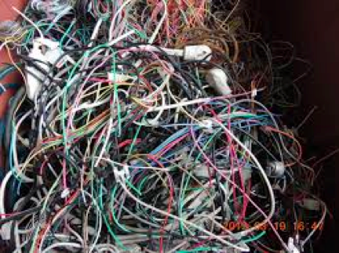
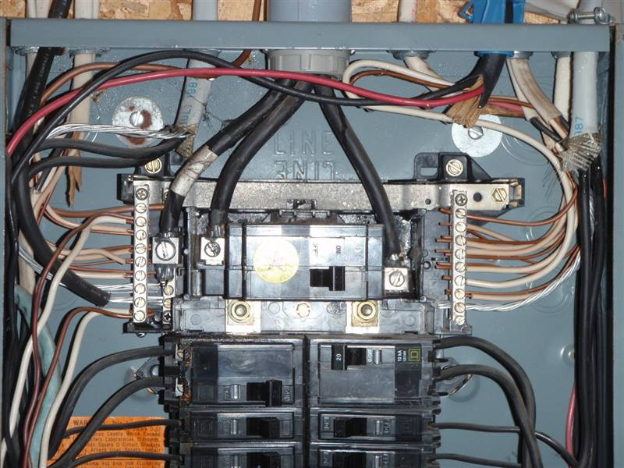
Wiring Tips: Wire Placement
Any components connected by wires should be put as close together as possible so wires can be conserved & the board kept cleaner and lighter.
Notes:
DESIGN
Color coding
numbering
thinking about spacing on electrical board
what kind of layout for board
take into account size of components

Slide 17
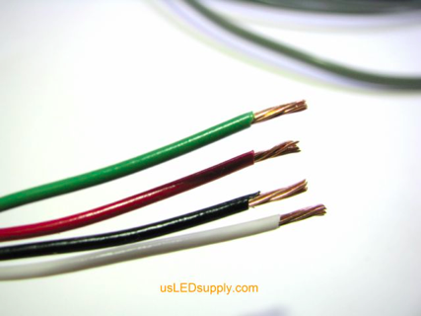
Wire Cutting
Try to keep wires just as long as you need them to form the needed connection
Initially wires are cut to be a 3-6 inches longer so wires can be cut shorter if needed
Notes:
materials for electrical board
non conductive
lexan, wood, something or something like that
electrical board location
central location
organization of board
leave room for routing wires
zipties
tiedowns

Slide 18
Wire Cutting cont.
Measure needed wire’s length and cut the wire 3-6 inches longer than necessary
Solder on the needed connectors and power pulls for your wire.
Connect the wire to where it needs to go
Properly adjust wire length so it can be attached to power supply (PDP)
Notes:
overall note: make sure you are saying more than just what is written on the slides. I recommend using this handy dandy notes section to remind you of what you are going to say outside of what is written

Slide 19
Color Coding
Use vinyl marking tape to color code & use two different colors per set of wires.
Color code so that you know what everything is and so the programming subteam can identify where the wires are plugged into or run to.
Notes:
We put the two color combination at several points along the wire so we know which wires lead to which components from any point on the wire

Slide 20
Electrical Board Tips
Materials to use for making an electrical board
non conductive
lexan, wood, something or something like that
Electrical board location
central location
Organization of board
leave room for routing wires
Use zipties or tiedowns to help route

Slide 21
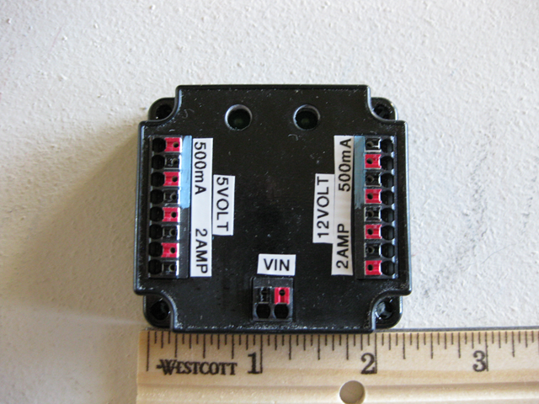
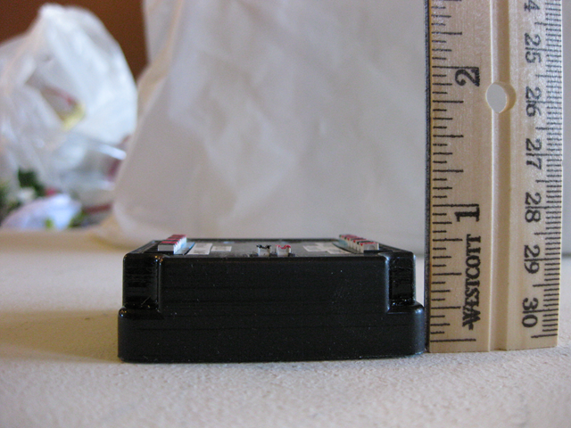
Voltage Regulator Module Function
It provides 500ma or 2A at both 5 and 12 volts. Power is supplied from one of the fused connectors on the Power Distribution Panel.

Slide 22
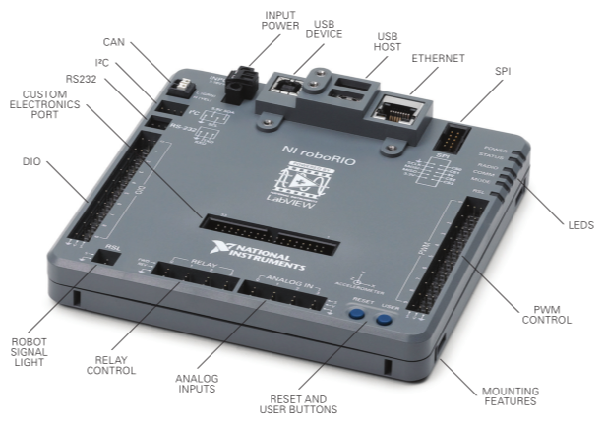
Parts of the roboRio
Notes:
Analog inputs - sensors
Relay controls -
the part called the CEP will be talked about a little later.
SPI RS232 and I2C -
can input

Slide 23
The roboRio
The roboRio uses NI Real-Time Linux OS, which is used in most of NI new Rio Devices
The roboRIO has 3 mounting features
2 ways to zip tie the roboRIO down
1 way to bolt the roboRIO into place

Slide 24
Programming Languages of the roboRio
The roboRio supports the following Programming languages
LabVEIW
Java
C++

Slide 25
Custom Electronics Port
Allows the expansion of the of the Control System I/O based on the specific needs
-Preliminary Definitions:
Active Device or Circuit: Any device or circuit capable of dynamically controlling and/or converting a source of electrical energy by the application of external electrical stimulus
MPX: myRIO Expantion Port (aka Custom Electronics Port)
Passive Device or Circuit: Any device or circuit whose capability is limited to the conduction and/or static regulation of the electrical energy applied to it (e.g. wire, splices, connectors, printed wiring board.)
Notes:
say the frc blog post about the MPX

Slide 26
Custom Electronics Port Cont.
Preliminary Rules:
MPX1: if a motor or servo is controlled via the MPX, it must be connected by one of the following methods
- directly to any PWM pins, via a network of Passive Devices and/or Circuits used to extend the PWM pins, or via one approved active device.
- Robots must be controlled by and only by the roboRIO
- No Rules prohibit co-processors, provided commands originate from the roboRio to configure, enable and specify all operating points for all power regulating devices. (includes devices legally wired to the CAN- Bus
-Custom Electronics must use appropriately sized wire.

Slide 27
Custom Electronics Port Cont.
Limits on motors, actuators, and power regulating devices for actuators will be defined
Pneumatic solenoid valves and electric solenoid actuators may not be controlled via the MPX
Custom electronics and circuits must not modify the power pathways between the battery, PDP, VRM, PCM, motor controllers, roboRIO, RSL, wireless bridge, main breaker, relay, or motors.
Only the robot’s wireless bridge may be used for wireless communication.

Slide 28
Custom Electronics Port Cont.
Approved Active Device Specifications:
The Active Device must be designed and produced such that
PWM pins must be a direct pass-through
The breakouts for PWM pins are visibly oblivious
-The Active device must be previously approved by FIRST.
All Most recent MPX rules are located at http://www.usfirst.org/roboticsprograms/frc/blog-myRIO-Expansion-Port-Its-back

Slide 29
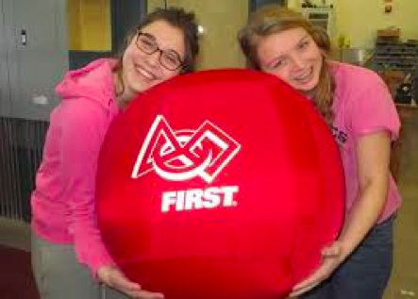
Thank you and good luck!

